Slide 1
Intermediate Results

Slide 2
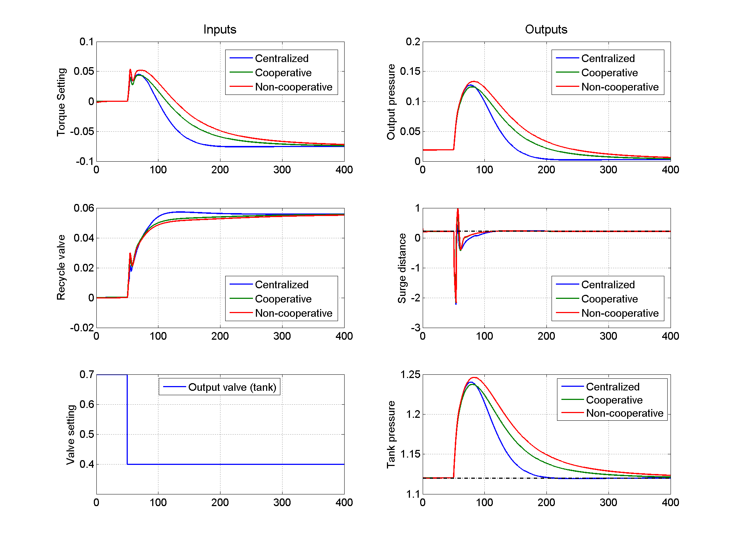
Parallel: Observer fixed
What to use to evaluate performance?
Inf-norm of surge distance
Rise/settling time of surge distance
Settling time of pressure
Inf/2-norm of pressure error

Slide 3
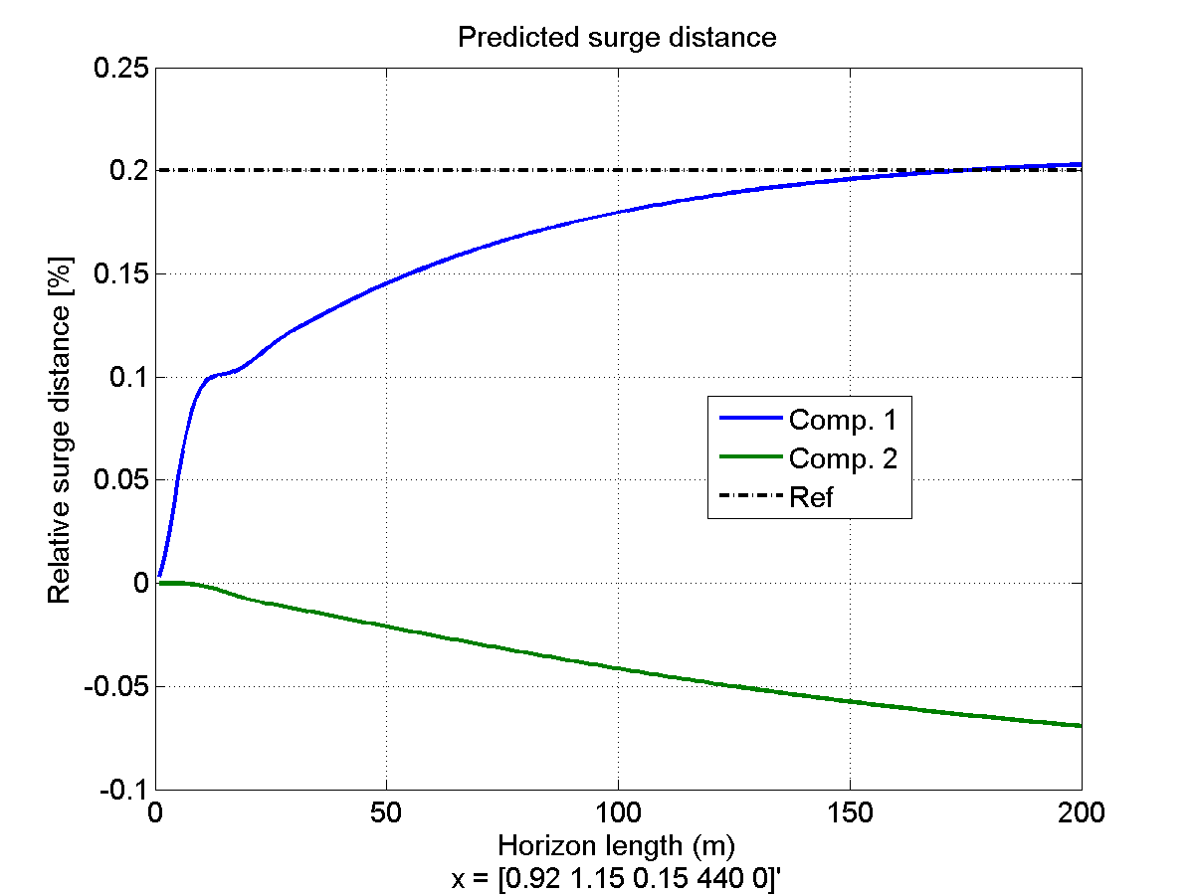
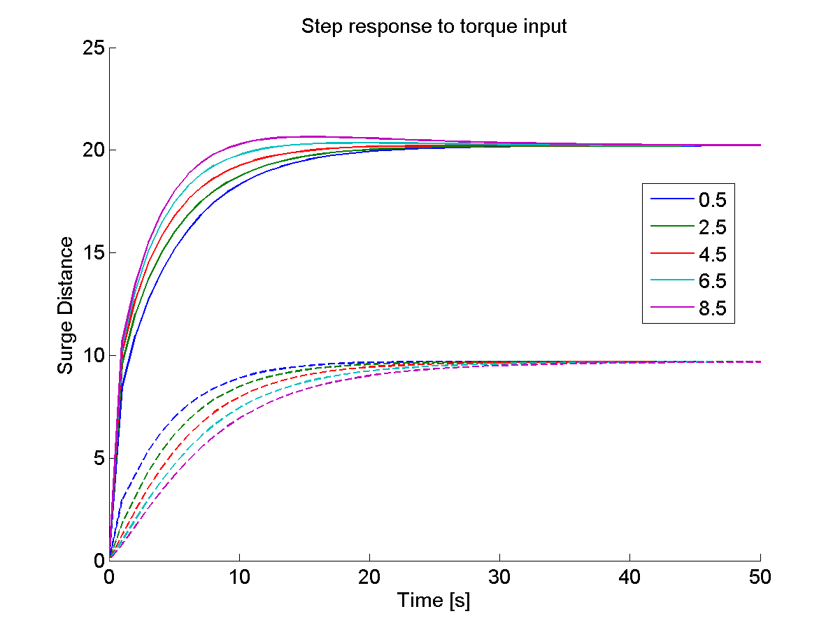
Parallel: Linearization fixed
Doesn’t change MPC results much
Now linearization makes more sense
Same compressor as torque input
Tank volume
Opposite compressor as torque input
(SD is negative)

Slide 4
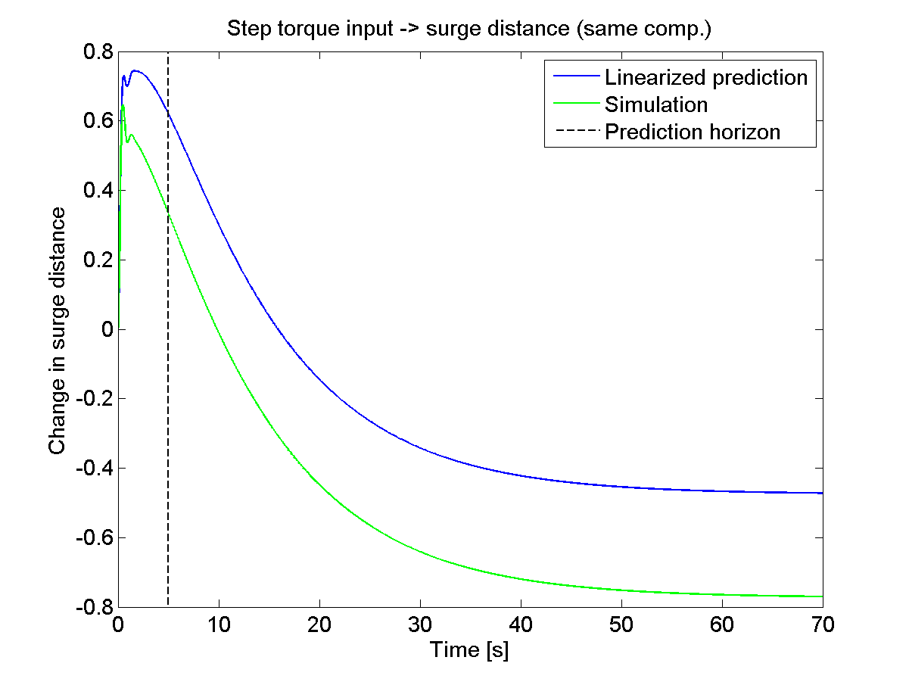
Serial: destabilizing controller
Would need a very long prediction horizon to capture the effect of the torque input
Currently: controller is destabilizing

